Slide 1
NEURAL ARCHITECTURE SEARCH WITH REINFORCEMENT LEARNING

Slide 2
ICLR 2017
Oral

Slide 3
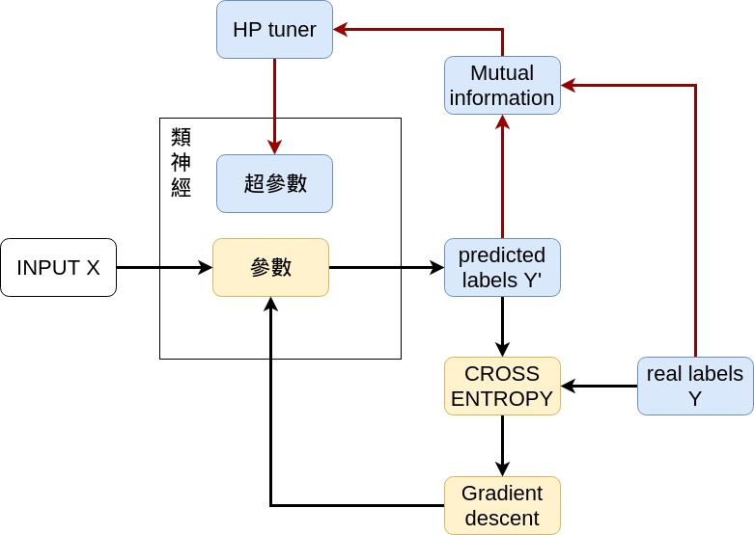
類神經構圖

Slide 4
ABSTRACT
96.35
RNN用reinforcement learning調參數

Slide 5
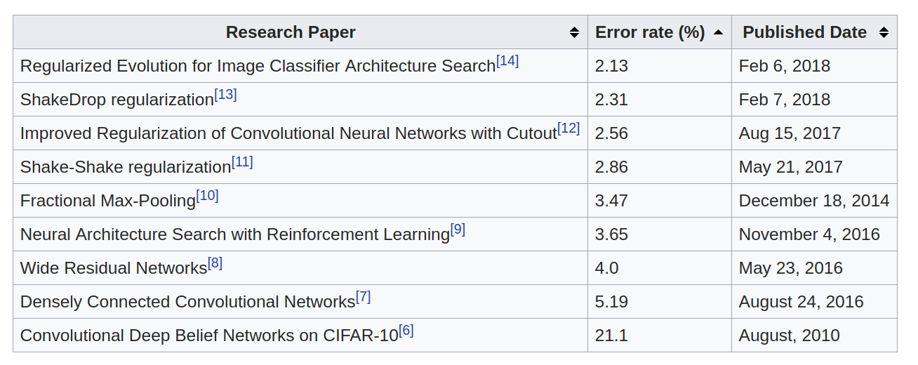
CIFAR-10

